Slide 1
Graph Mining
The task of graph mining is to extract patters (sub-graphs) of interest from graphs, that describe the underlying data and could be used further, e.g., for classification or clustering.
Graph mining has a vast number of applications, e.g. biological networks or web data.
Cheminformatics is another important application of graph mining: frequent sub-graph mining can yield structural alerts, i.e., structural sub-graphs that have a huge impact on the activity of chemical compounds.

Slide 2
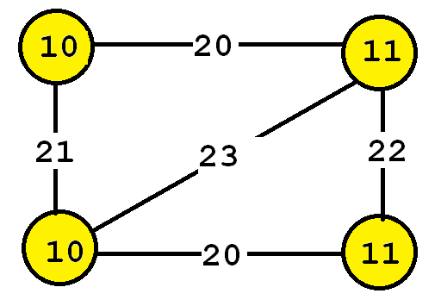
What is a graph?
A graph is a set of vertices and edges, having some labels.
This graph contains four vertices (depicted as yellow circles).
These vertices have labels such as “10” and “11”.
These labels provide information about the vertices.

Slide 3
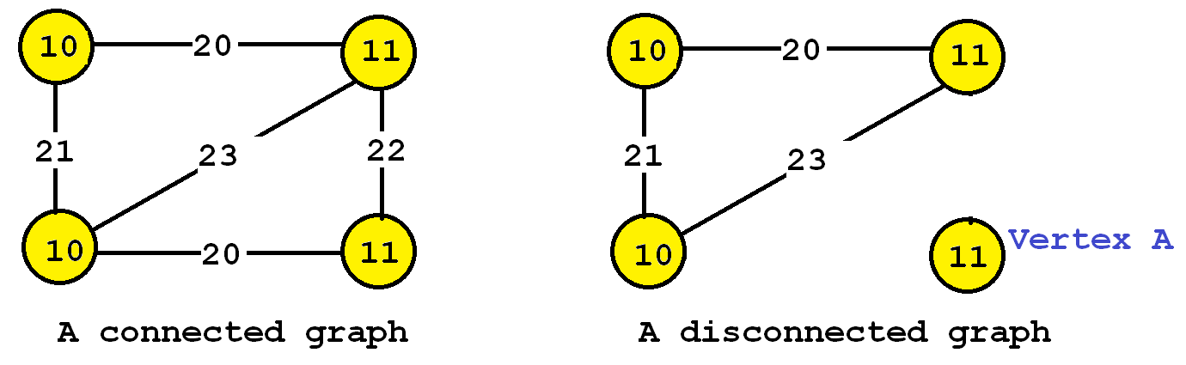
Types of graphs:
1. Connected and
2. Disconnected

Slide 4
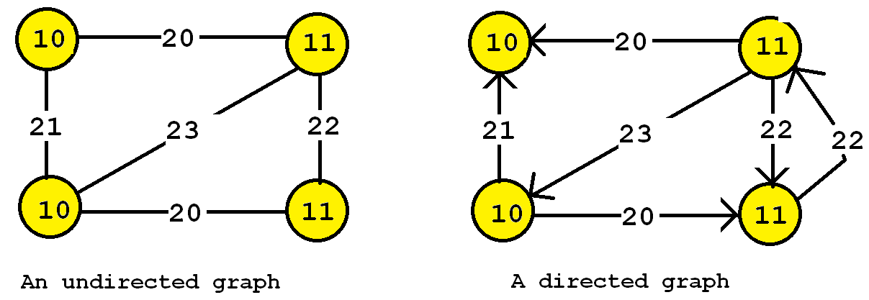
Differences:
It is also useful to distinguish between directed and undirected graphs.
In an undirected graph, edges are bidirectional, while in a directed graph, the edges can be unidirectional or bidirectional.
Some data mining algorithms are designed to work only with undirected graphs, directed graphs, or support both.

Slide 5
Frequent Subgraph Mining:
The task of finding frequent subgraphs in a set of graphs is called frequent subgraph mining.
As input the user must provide:
1. A graph database (a set of graphs)
2. A parameter called the minimum support threshold (minsup).
Then, a frequent subgraph mining algorithm will enumerate as output all frequent subgraphs.
A frequent subgraph is a subgraph that appears in at least minsup graphs from a graph database.

Slide 6
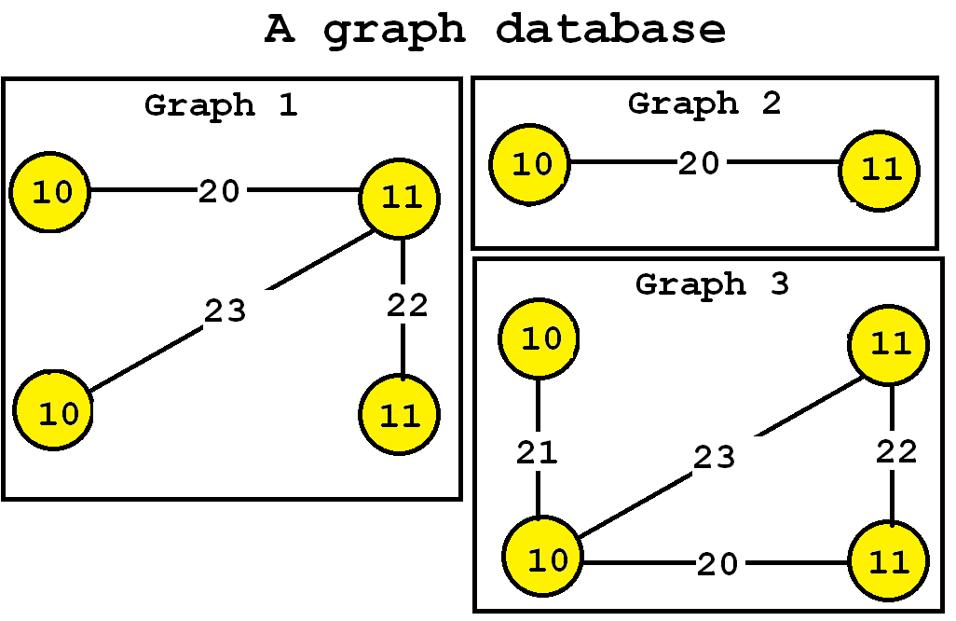

Slide 7
From Database…
Now, let’s say that we want to discover all subgraphs that appear in at least three graphs.
Thus, we will set the minsup parameter to 3.
By applying a frequent subgraph mining algorithm, we will obtain the set of all subgraphs appearing in at least three graphs:

Slide 8
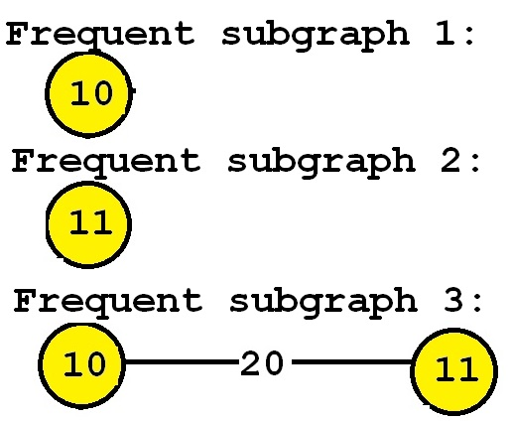

Slide 9
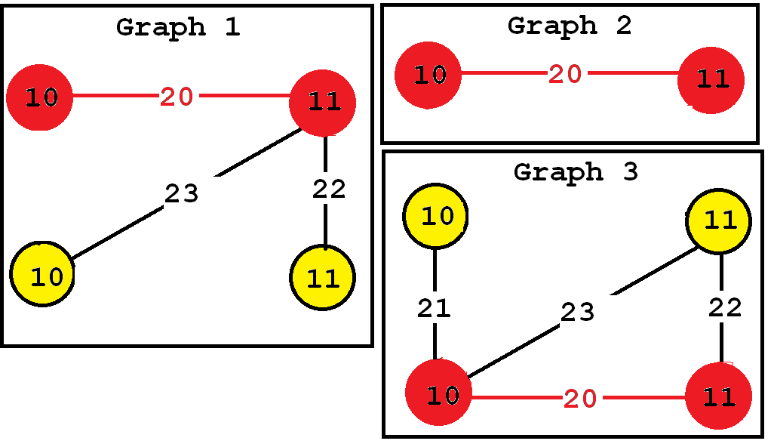
Consider the third subgraph (“Frequent subgraph 3”).
This subgraph is frequent and is said to have a support (a frequency) of 3 since it appears in three of the input graphs.
These occurrences are highlighted in red, below:

Slide 10
Tools Or Algorithms:
In practice, the minsup parameter is generally set by trial and error.
If this parameter is set too high, few subgraphs will be found, while if it is set too low, hundred or millions of subgraphs may be found, depending on the input database.
There exists various frequent subgraph mining algorithms.
Some of the most famous are GASTON, FSG, and GSPAN.

Slide 11
Mining frequent subgraphs in a single graph
Besides discovering graphs common to several graphs, there is also a variation of the problem of frequent subgraph mining that consists of finding all frequent subgraphs in a single graph rather than in a graph database.
The goal is to discover subgraphs that appear frequently or that are interesting.
The only difference is how the support (frequency) is calculated.
For this variation, the support of a subgraph is the number of times that it appears in the single input graph.

Slide 12
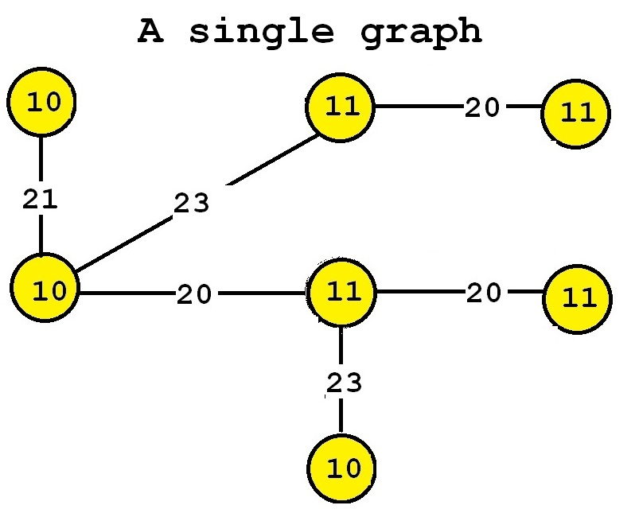
For example, consider the following input graph:
This graph contains seven vertices and six edges.
If we perform frequent subgraph mining on this single graph by setting the minsup parameter to 2,
we can discover the five following frequent subgraphs:

Slide 13
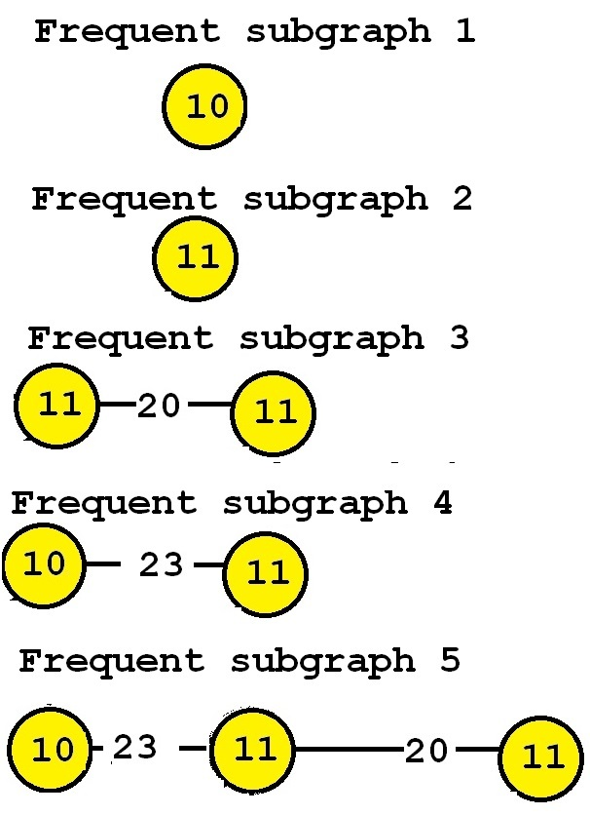
Five Sub Graphs

Slide 14
These subgraphs are said to be frequent because they appear at least twice in the input graph.
For example, consider “Frequent subgraph 5”.
This subgraph has a support of 2 because it has two occurrences in the input graph.
Those two occurrences are highlighted below in red and blue, respectively.

Slide 15
